Slide 1
Municipal Networks
Christopher Mitchell
Director, Community Broadband Networks
Institute for Local Self-Reliance
April 4, 2023
@CommunityNets
CommunityNets.org

Slide 2
Institute for Local Self-Reliance
ilsr.org
Formed in 1974
Focuses
Local Banking
Decentralized Energy
Main Street Businesses
Recycling – Waste to Wealth
Community Broadband Networks
CommunityNets.org
Notes:
Thank You
NCLM
Ting
Dawn

Slide 3
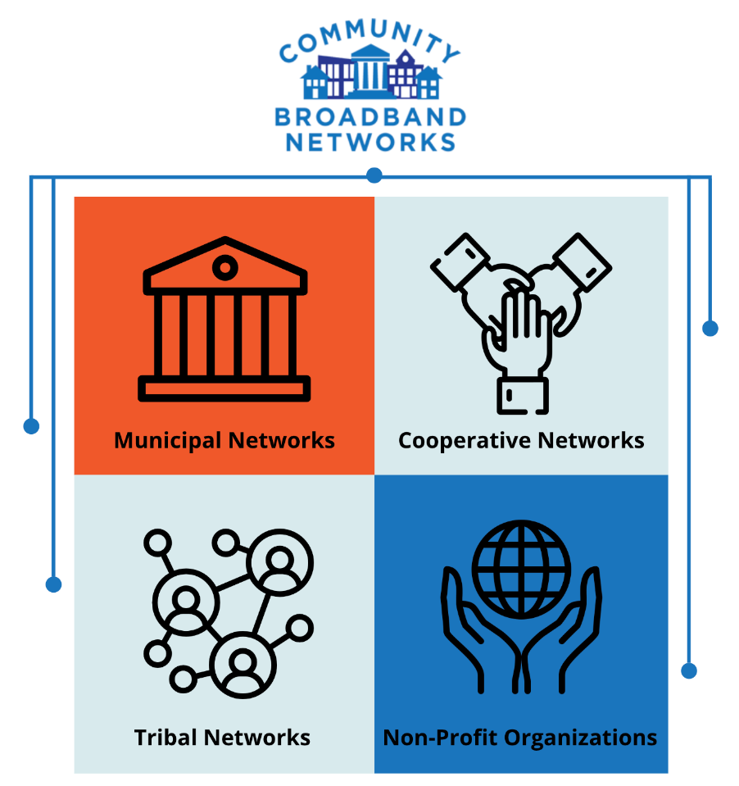
Different Focus
Nonprofit – but financially sustainable if possible
Focus on community benefits
Correcting market failure

Slide 4
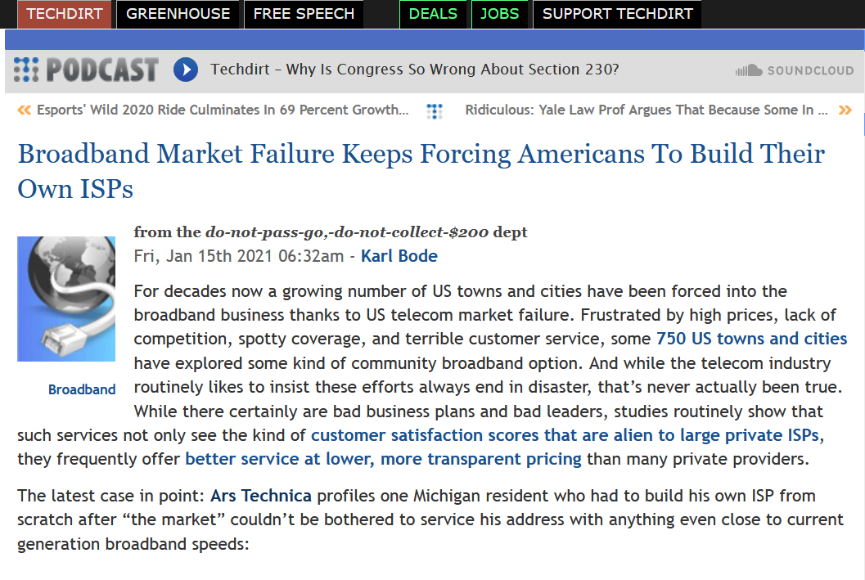
Why Municipal Broadband?
Market Failure
Failure of Federal Government, Federal Communications Commission
History of success with municipal electricity

Slide 5
Poverty and Power, not Technology
Half of humanity is connected to high-quality Internet access.
The other half will not be connected by the business models that connected the first half.
ConnectHumanity.fund/report-financing-ccps/

Slide 6
Lessons from U.S. Cities
It is not easy
Different from other city services
Define and remind everyone of the goals and metrics
unsplash.com/photos/kcT-7cirBEw

Slide 7
Gap Networks – Life Rafts
bit.ly/Digital-Equity-Solutions

Slide 8
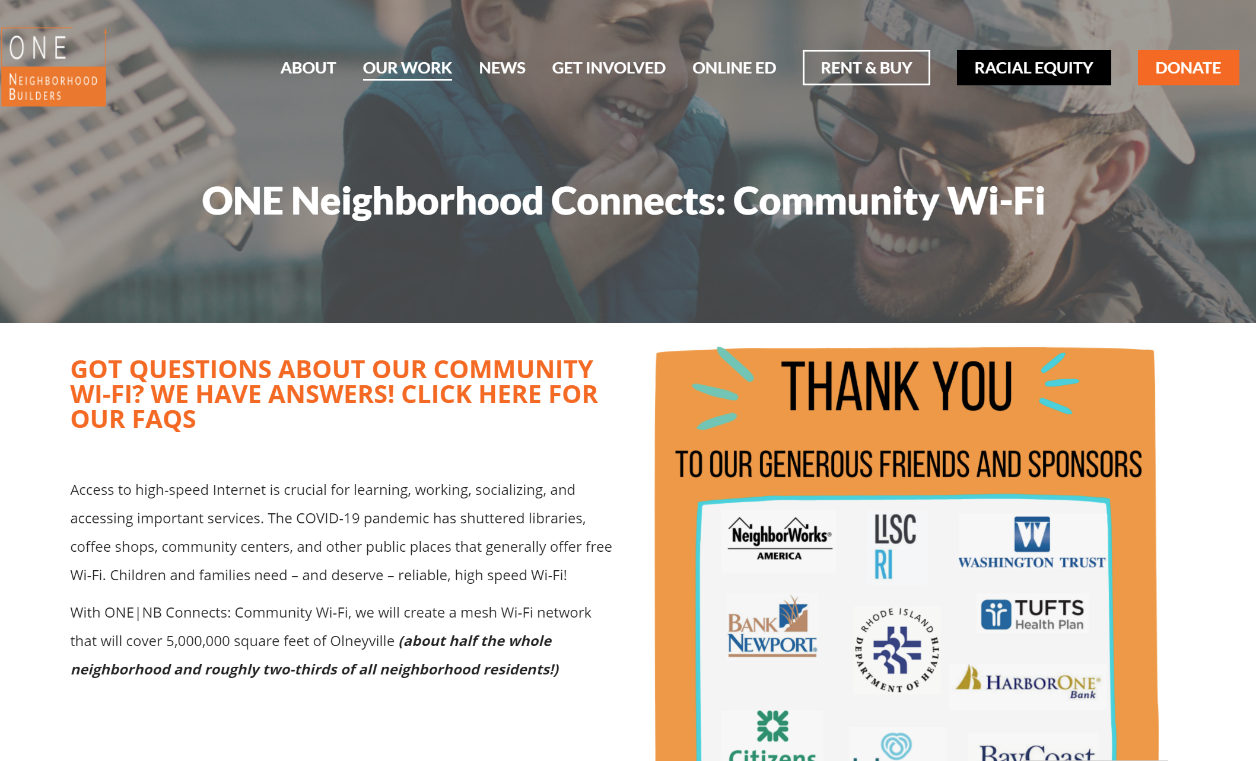
Gap Networks - Providence
MuniNetworks.org/tags/tags/rhode-island

Slide 9
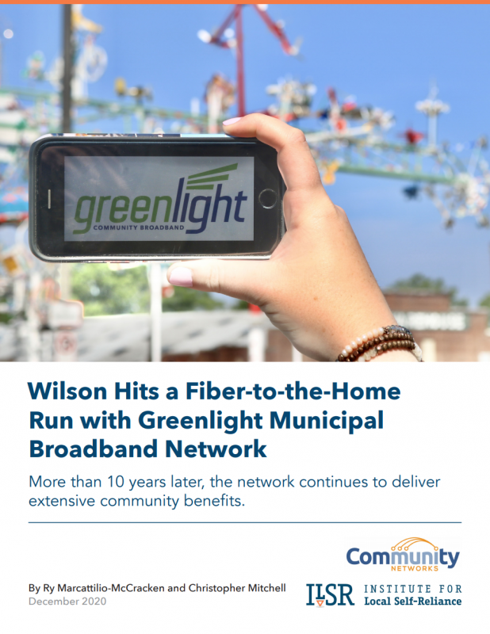
Municipal Retail Service
“Greenlight” in Wilson, North Carolina
Municipal Utility: Electricity, Natural Gas, Internet Access
Essential for the Economy
Focus on Low-Income Households
Sticky Prices
MuniNetworks.org/reports/edit-report-wilson-hits-fiber-home-run-greenlight-municipal-broadband-network

Slide 10
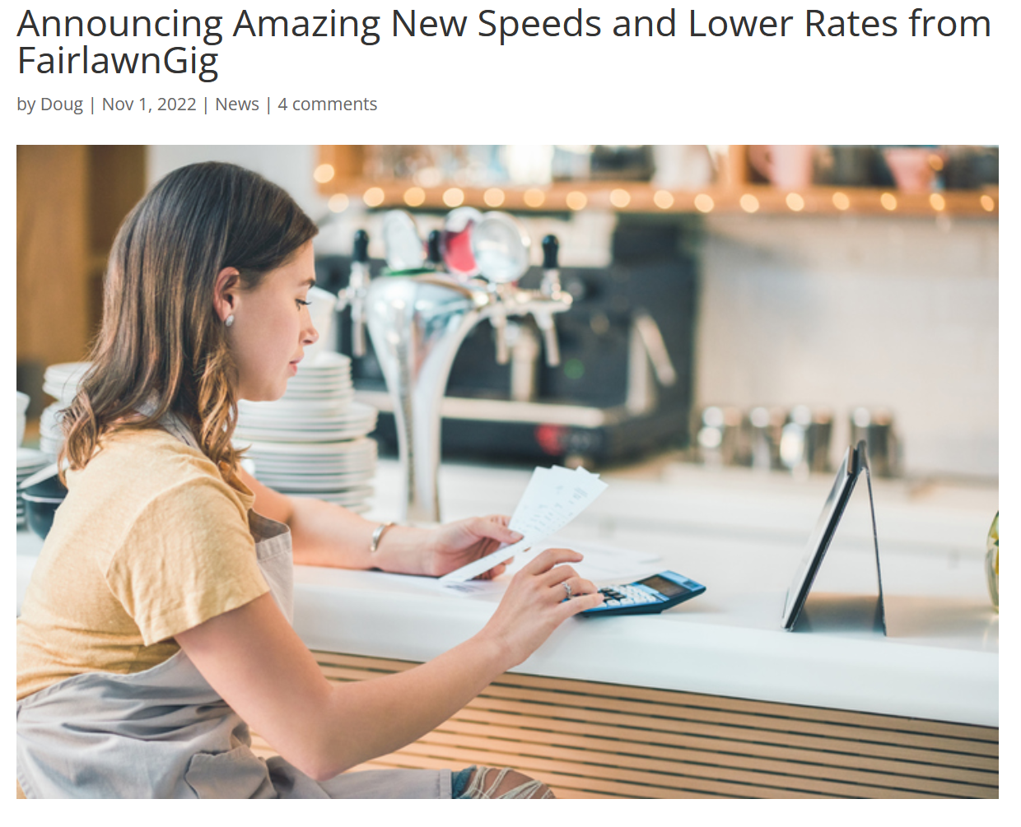
https://www.fairlawngig.net/announcing-amazing-new-speeds-and-lower-rates-from-fairlawngig/

Slide 11
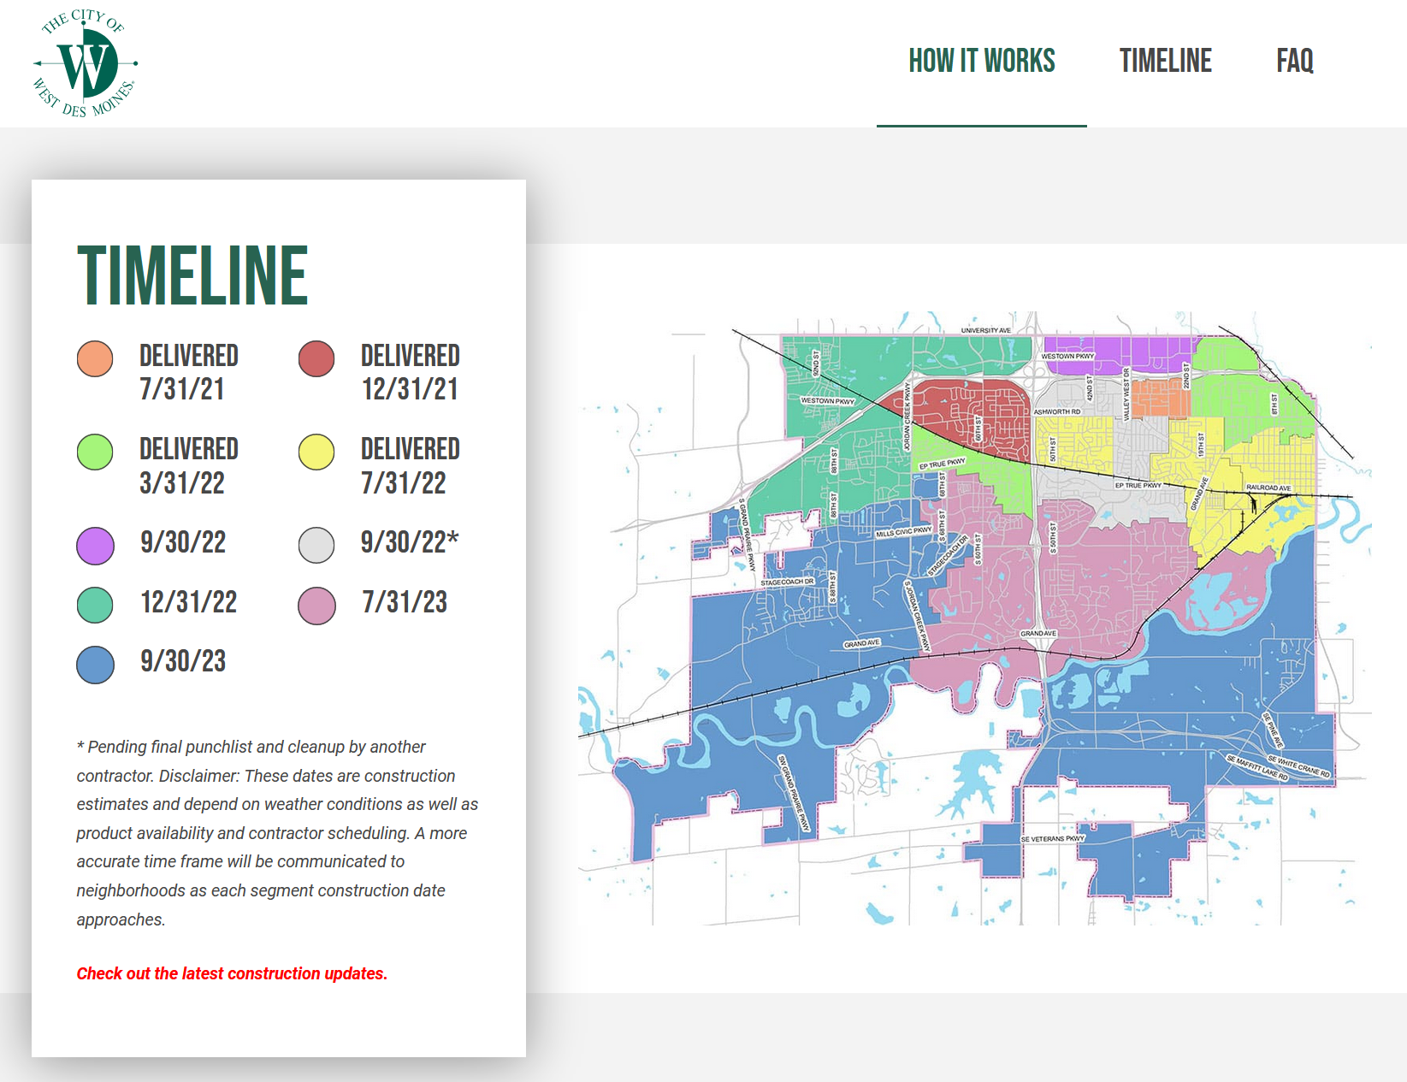
Partnerships
Definitions vary
Examples
Google Fiber in West Des Moines, Iowa and Huntsville, Alabama
Ting in Westminster, Maryland
wiredwdm.org

Slide 12
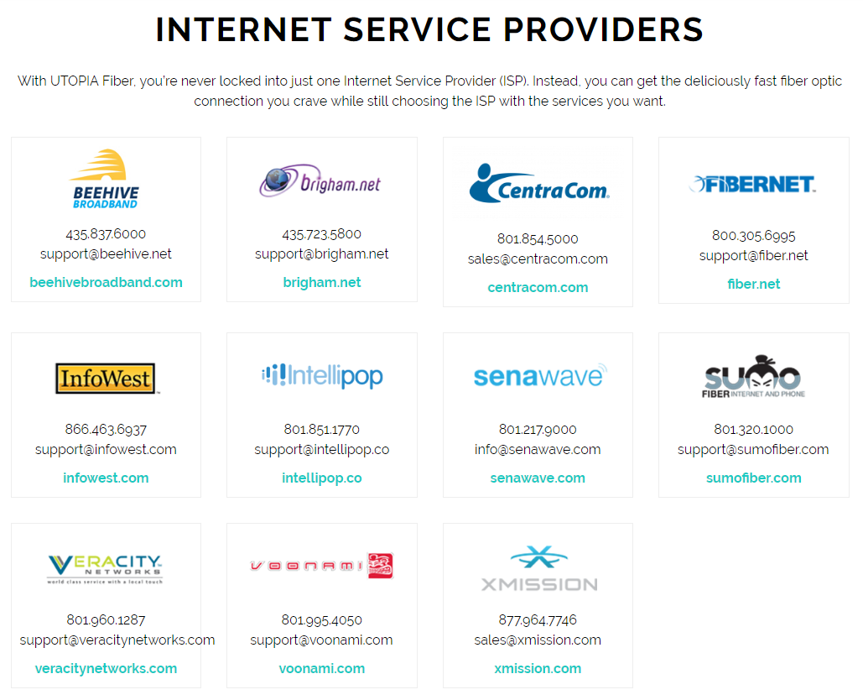
Open Access
bit.ly/ammon-lid-fiber

Slide 13
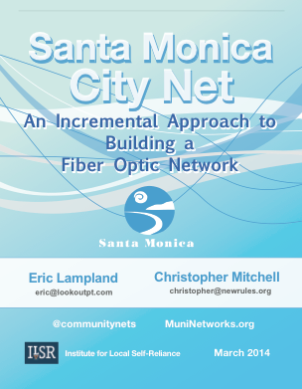
Dark Fiber / Conduit
Focus on passive infrastructure
Dark Fiber Examples:
Santa Monica, California
Palo Alto, California
Conduit Examples:
Lincoln, Nebraska
ilsr.org/santa-monica-city-net

Slide 14
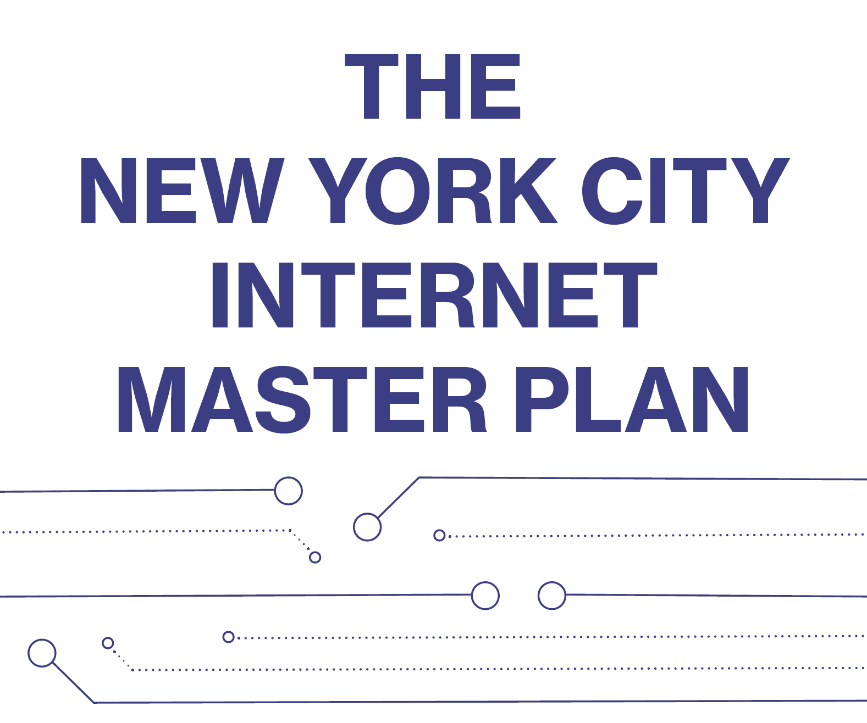
www1.nyc.gov/assets/cto/#/project/internet-master-plan

Slide 15
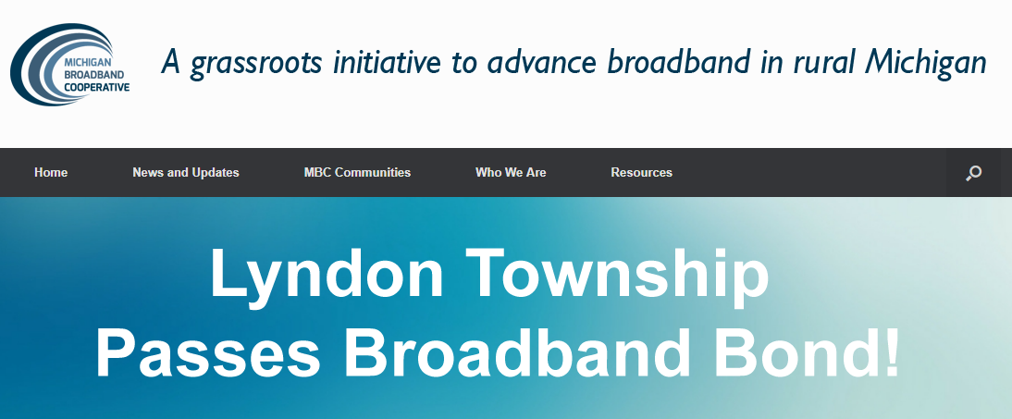
Common Financing Tools
Bonds
Backed and Unbacked
Tax Dollars
Existing Budgets (Fairlawn, Ohio; Rio Blanco County, Colorado)
Property Taxes (Leverett, Massachusetts; Lyndon Township, Michigan)
Loans (frequently existing utilities)
Grants
www.mbcoop.org

Slide 16
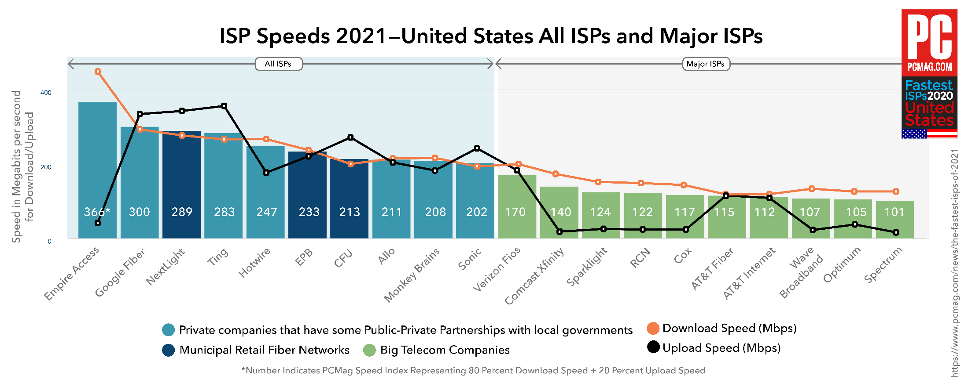

Slide 18
